Slide 1

Data Processing 1
Dr. Zainab Malik
Pensyarah Kanan | Senior Lecturer
Department of Artificial Intelligence
Faculty of Computer Science and Information Technology

Slide 2
Outline
Part 1
Why preprocess the data?
Data cleaning
  Incomplete
  Noise
  Inconsistent
Part 2 (After Mid Break)
Data integration
Data transformation
Data reduction
Summary

Slide 3
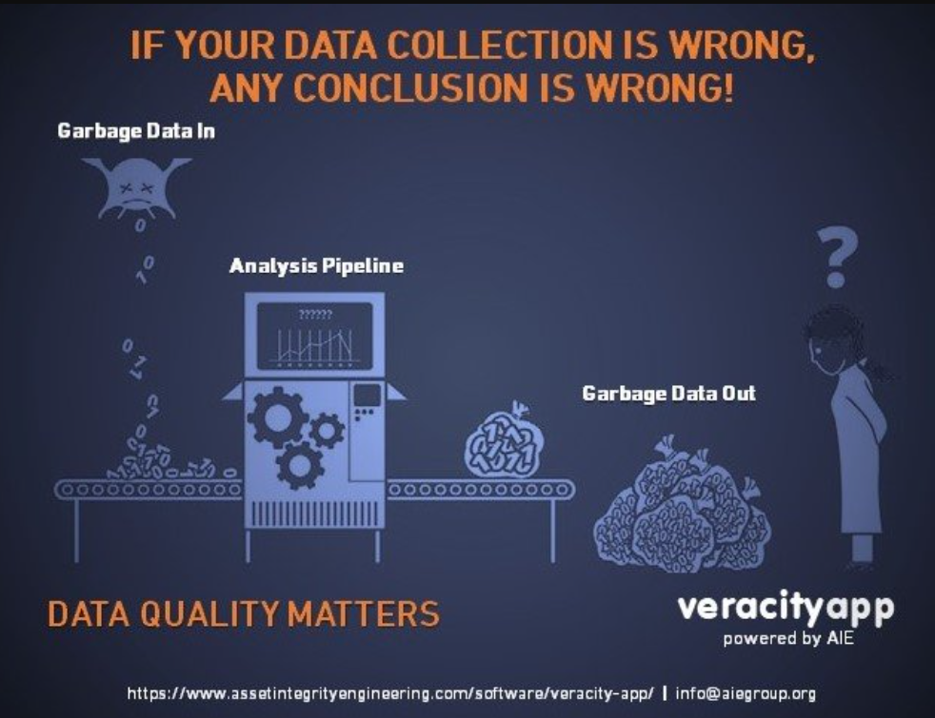

Slide 4
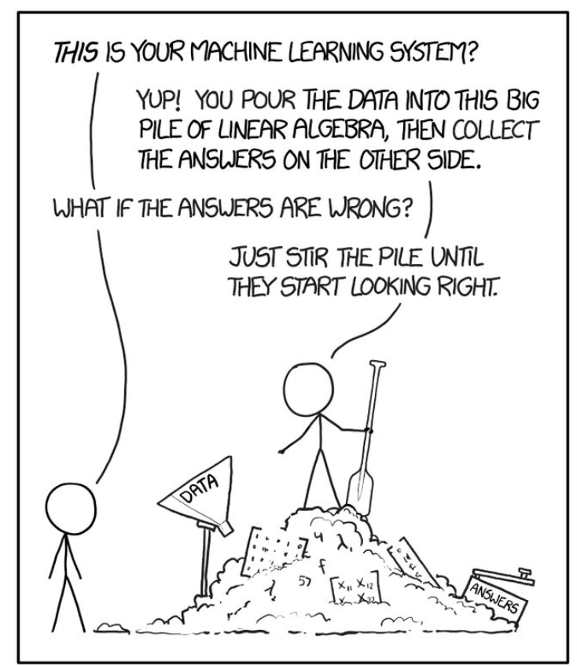

Slide 5
Model-centric vs. Data-centric approach
Model-Centric Approach (Path-A)
If the model's predictions are inaccurate, the team focuses on the algorithm.
  Tune Hyperparameters: Endlessly adjust the "knobs" of the model (e.g., learning rate, number of layers).
  Try New Architectures: Switch from a Decision Tree to a Random Forest, or to a complex Deep Neural Network.
  "Stir the Pile": Experiment with different mathematical techniques to squeeze out more performance from the existing dataset.
Data-Centric Approach (Path-B)
If the model's predictions are inaccurate, the team goes back to the data.
  Clean: Fix typos, handle missing values.
  Label Consistently: Ensure that "Cofe" and "Coffee" are the same thing.
  Augment: Collect more data for under-represented cases.
  Engineer Features: Create new, more informative data columns from existing ones.

Slide 6












Why preprocess data?
Dirty data
incomplete
lacking attribute values, lacking certain attributes of interest, or containing only aggregate data
e.g., occupation=“ ” (missing data)
inconsistent
containing discrepancies in codes or
names, e.g.,
Age=“42” Birthday=“03/07/1997”
Was rating “1,2,3”, now rating “A, B, C”
discrepancy between duplicate records
noise
containing noise, errors, or outliers
e.g., Salary=“−10” (an error)

Slide 7
Why Is Data Dirty?
Incomplete data may come from
  “Not applicable” data value when collected
  Different considerations between the time when the data was collected and when it is analyzed.
  Human/hardware/software problems
Noisy data (incorrect values) may come from
  Faulty data collection instruments
  Human or computer error at data entry
  Errors in data transmission
Inconsistent data may come from
  Different data sources
  Functional dependency violation (e.g., modify some linked data)
Duplicate records also need data cleaning

Slide 8
Why Preprocessing is Important?
No quality data, no quality mining results!
  Quality decisions must be based on quality data
    e.g., duplicate or missing data may cause incorrect or even misleading statistics.
  Data warehouse needs consistent integration of quality data
Data extraction, cleaning, and transformation comprises the majority of the work of building a data warehouse.
— Bill Inmon

Slide 9
Outline
General data characteristics
Why preprocess the data?
Data cleaning
Data integration
Data transformation
Data reduction
Summary

Slide 10
Data Cleaning
To clean data from:
  Incomplete /missing data
  Noisy data
  Inconsistent /outliers
Importance
  “Data cleaning is one of the three biggest problems in data warehousing”—Ralph Kimball
  “Data cleaning is the number one problem in data warehousing”—DCI survey
Data cleaning tasks
  Fill in missing values
  Identify outliers and smooth out noisy data
  Correct inconsistent data
  Resolve redundancy caused by data integration

Slide 11
Missing Data
Data is not always available
  E.g., many tuples have no recorded value for several attributes, such as
customer income in sales data
Missing data may be due to
  equipment malfunction
  inconsistent with other recorded data and thus deleted
  data not entered due to misunderstanding
  certain data may not be considered important at the time of entry
  not register history or changes of the data
Missing data may need to be inferred

Slide 12
How to Handle Missing Data?
Ignore the tuple: usually done when class label is missing (when doing classification)—not effective when the % of missing values per attribute varies considerably
Fill in the missing value manually: tedious + infeasible?
Fill in it automatically with
  a global constant : e.g., “unknown”, a new class?!
  the attribute mean
  the attribute mean for all samples belonging to the same class: smarter
  the most probable value: inference-based such as Bayesian formula or
decision tree

Slide 13
Handle Missing Data
Method | Pros | Cons | Best For
Ignore Tuple | Simple | Wastes data, can lose a lot of rows | Missing class labels, very few missing values
Global Constant | Very simple | Can create false patterns | Quick prototypes
Attribute Mean | Simple, preserves mean | Ignores correlations, reduces variance | Numerical data, low missingness
Class-Based Mean | Smarter, uses label info | Still ignores other feature correlations | Classification problems
Most Probable Value | Most accurate, uses all data | Complex, computationally heavy | Critical applications, large datasets
Delete Attribute | Removes a problematic feature | Loses all information in that column | Columns with a very high % of missing data

Slide 14
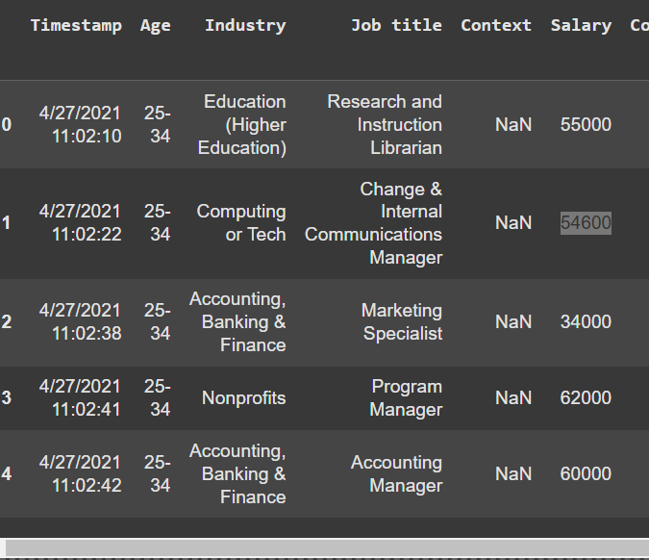

Slide 15
Problem | Type of Issue | Why it's Problematic | Recommended Handling Method
Inconsistent Salary (Row 1) | Data Entry Error | Skews averages and statistics | Verify and Correct or Data Smoothing
Missing Context Values | Missing Data | Useless column; wastes resources | Delete the entire column
Non-Standardized Industry | Inconsistent Data | Causes incorrect grouping in analysis | Standardize values to a controlled vocabulary
Redundant Timestamp | Irrelevant Data | Adds noise without analytical value | Delete the entire column
Single Age Bracket | Data Sufficiency | Makes analysis of age vs. salary impossible | Collect more data (not a cleaning task)

Slide 16
Noisy Data
Noise: random error or variance in a measured variable
Incorrect attribute values may due to
  faulty data collection instruments
  data entry problems
  data transmission problems
  technology limitation
  inconsistency in naming convention
Other data problems which requires data cleaning
  duplicate records
  incomplete data
  inconsistent data

Slide 17
How to Handle Noisy Data?
Binning
  first sort data and partition into (equal-frequency) bins
  then one can smooth by bin means, smooth by bin median, smooth by bin boundaries, etc.
Regression
  smooth by fitting the data into regression functions
Clustering
  detect and remove outliers
Combined computer and human inspection
  detect suspicious values and check by human (e.g., deal with possible outliers)

Slide 18
Simple Discretization Methods - Binning
Equal-width (distance) partitioning
  Divides the range into N intervals of equal size: uniform grid
  if A and B are the lowest and highest values of the attribute, the width of intervals will be:W = (B –A)/N.
  The most straightforward, but outliers may dominate presentation
  Skewed data is not handled well
Equal-depth (frequency) partitioning
  Divides the range into N intervals, each containing approximately same number of samples
  Good data scaling
  Managing categorical attributes can be tricky

Slide 19
Binning Methods for Data Smoothing
Sorted data for price (in dollars):
4, 8, 9, 15, 21, 21, 24, 25, 26, 28, 29, 34
Partition into (equi-depth) 4 bins:
  Bin 1: 4, 8, 9, 15
  Bin 2: 21, 21, 24, 25
  Bin 3: 26, 28, 29, 34
Smoothing by bin means:
  Bin 1: 9, 9, 9, 9
  Bin 2: 23, 23, 23, 23
  Bin 3: 29, 29, 29, 29
Smoothing by bin boundaries:
  Bin 1: 4, 4, 4, 15
  Bin 2: 21, 21, 25, 25
  Bin 3: 26, 26, 26, 34

Slide 20
Regression
y
Y1
Y1’
y = x + 1
X1
x

Slide 21

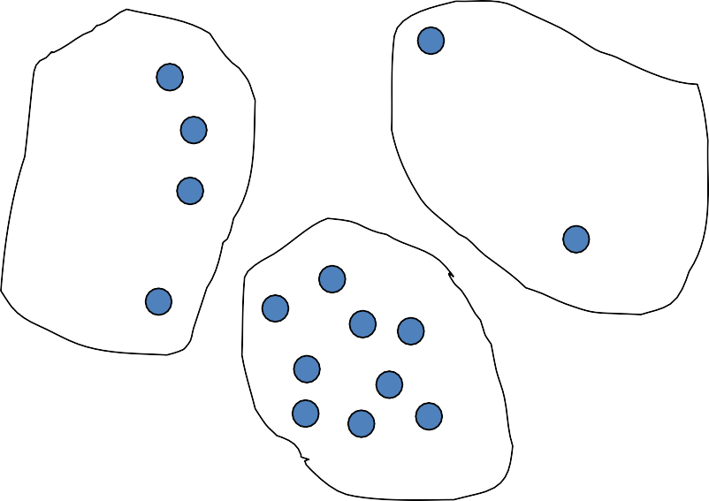



Cluster Analysis

Slide 22
Thank You

